Slide 1

Parish Re-engagement, Outreach and Hospitality

Slide 2
Re-thinking Re-engagement
Check out the OSV video: What if they don’t return?
    https://www.youtube.com/watch?v=VzFrBWBYKbw
Determine how to reach out to every parishioner (or every person) in your parish boundaries to let them know you are open and here to help and serve them.
Determine how your parish can be a place of hospitality to experience our Lord.
It all starts with prayer – Parish intercessors
Most parishes experienced a large increase of parishioners returning on Ash Wednesday…and the Sundays following!
  What is your parish doing when folks return to Mass?
    Give them a renewed experience of love
Notes:
Parish Intercessors – invite rosary group, Knights of Columbus, individuals and families to pray for the parish and for your efforts at Outreach as people return to the Sacraments.
St. Agnes is in the middle of a 33 Day Novena for the Faithful Returning to Church

Slide 3
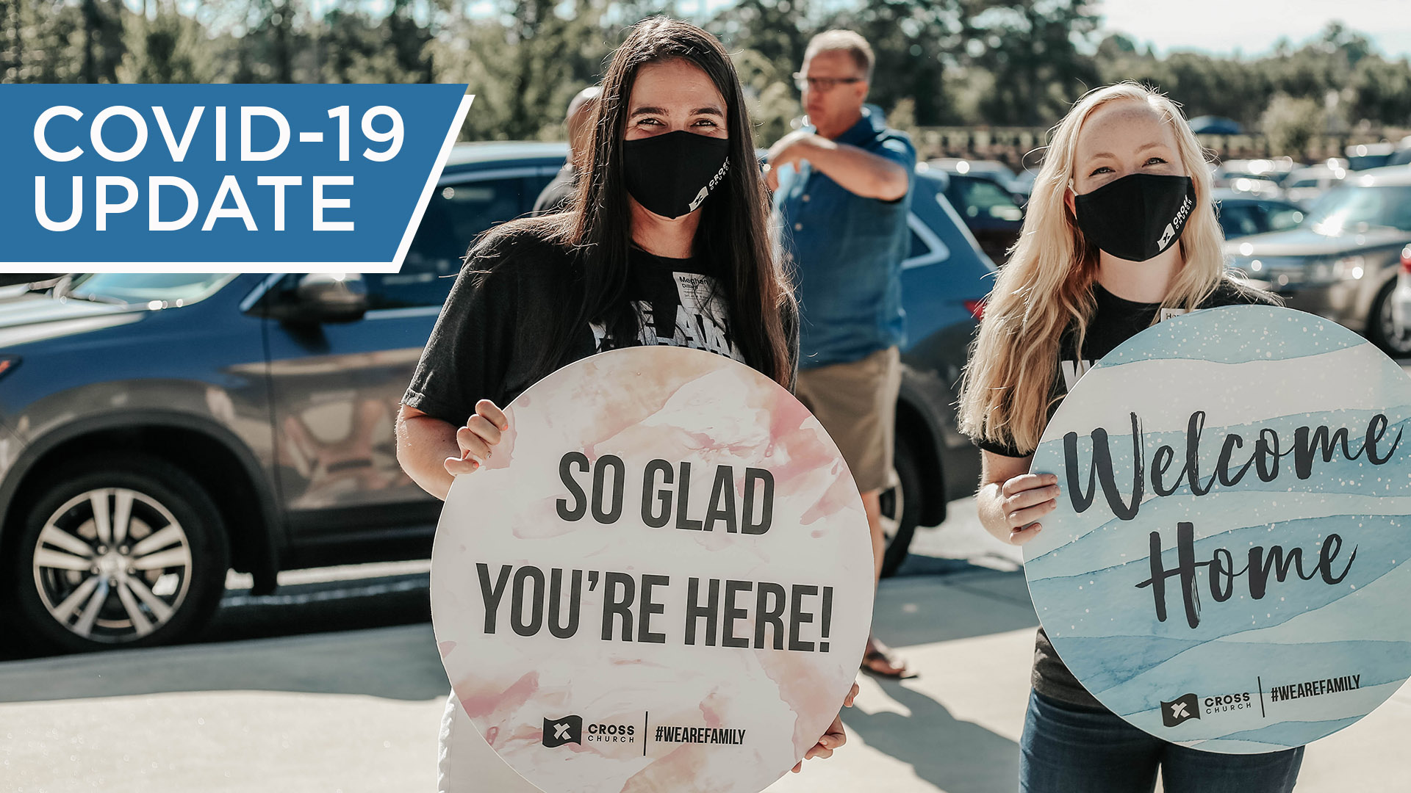
What “Welcome Back” Looks Like
Think about your Digital Presence
  It is where people will go before they return physically
  Is your website easy to read? Does it look professional?
  Are you using Facebook to let people know your open and what’s happening?
  Do you acknowledge those watching from home during your virtual Mass?
When they come back – Ask people in your parish that are outgoing to be Greeters at the door to welcome everyone!
Don’t just decorate the Altar! The Narthax is the first impression people have of the Church.
Create disposable programs on bright paper so everyone can follow along.
Consider giving a small gift to each family to thank them for coming back. Baskets for the kids!
Liz Lemon Swindle, Artist
Notes:
Virtual Masses – note that 64% of parish offer virtual Mass, Invite people to other virtual and in person events at your parish on the virtual connections, offer a link or way for people to give during the virtual Mass

Slide 4
Easter is Approaching – Continue to Connect
Thank you to all the Parishes that have actively been reaching out to their parishioners!
Reminder - Reach Out to ALL your parishioners before Easter.
  Passive Engagement: Letters, Email, Social media
  Active Engagement: Phone Calls to EVERY parishioner, home visits – where you can ask how they are doing, prayers, invite them personally back (hear concerns)
Form Parish Outreach and Reengagement teams.
If you have a unique idea that has worked really well for you, please feel free to share it in the CHAT.
Liz Lemon Swindle, Artist

Slide 5
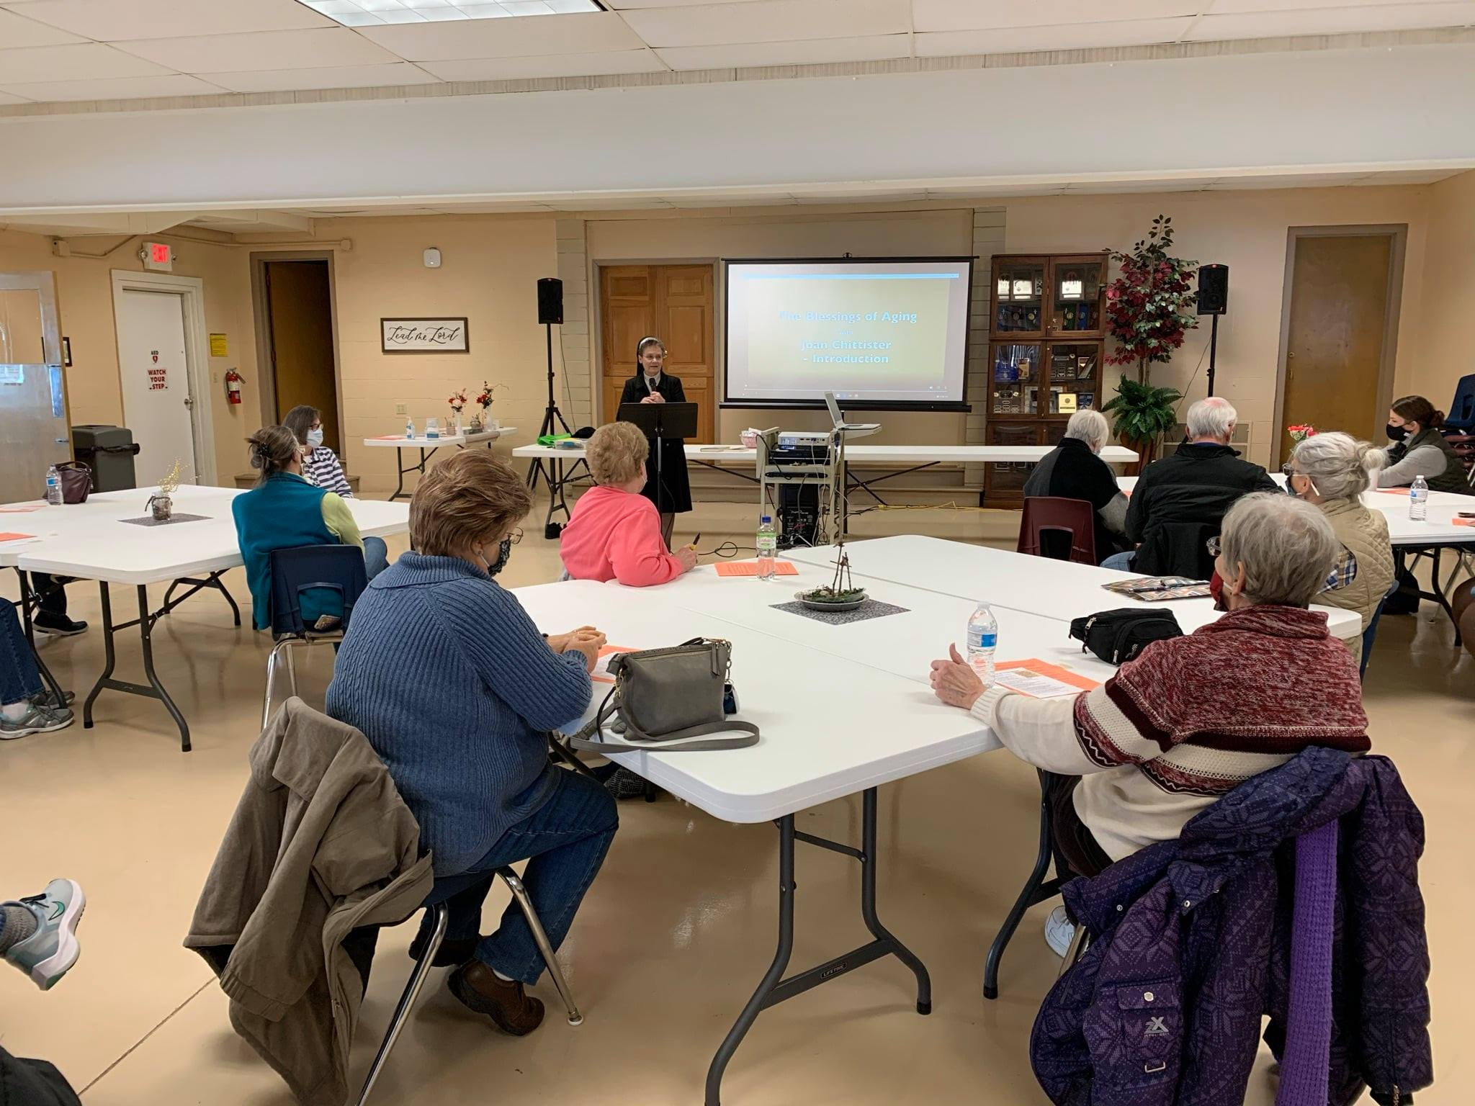
Here are Some Ideas to Help You
Diocese website
  New Outreach Calling Script for Easter
  St Paul Street Evangelization Material
  Catholic Charities Resources for physical, emotional, financial needs
Other Parishes
  Resurrection in Green Bay (YouTube Channel)
  St Mary’s in Omro and Winnecone (Facebook)
  Sacred Heart in Shawano (Mass contains a link for donations)
  St Mary Algoma (Drive up Fish Boil)
  Holy Family Marinette (Mailing to all parishioners with a targeted calling campaign to families)
Replace this box with an image.
Soupless Sermon 2021 at St Mary’s

Slide 6
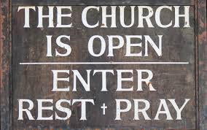
“Often when you think you're at the end of something, you're really at the beginning of something else.”
– Fred Rodgers
Notes:
Over the next several months we will continue to offer Reengagement and Outreach resources and guidance…especially as the affects of the pandemic decrease. We have conducted surveys and focus groups that will help guide a plan for reengagement over the next several months. Don’t wait, start gathering in your parish and start helping people experience Christ through your welcome, the Sacraments and the community of believers.
This is more than just getting people back in the pews…this is about being the Church that Jesus Christ founded to reach out and evangelize the whole world. Do not fear…”He that is in us is greater than he that is in the world”…we can do all things in Christ who strengths us.

Slide 7
Thank you!
Feel free to contact us at:
Dr. Peter Murphy --- pmurphy@gbdioc.org
Lori Paul --- lpaul@gbdioc.org
If you have any reengagement needs that Catholic Charities can assist with please contact – newcatholiccharities.org
(920) 272-8234
Toll-free: (877) 500-3580
Catholic Charities
PO Box 23825
Green Bay, WI 54305-3825
In person: 1825 Riverside Drive, Green Bay, WI 54301

