Slide 1
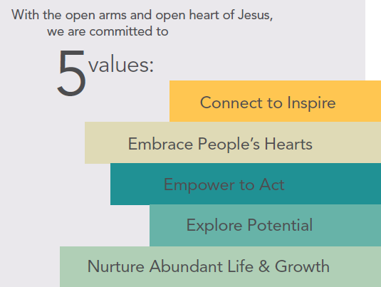

PPP2 Key Facts
Qualification Changes
  Must have Spent all PPP original funds. You do NOT have to have forgiveness complete to apply for PPP2 Funds
  Must have under 300 Employees
  Must have at least one quarter with an amount equal or greater than a 25% reduction in cash receipts as compared from annual 2019 vs. 2020

Slide 2
PPP2 Key Facts
How do I Apply and for how much?
  Application is almost identical to first application except for the process of attesting to the 25% reduction in cash receipts. (see attachment). You will need all your bank statements from 2019 and 2020 and any investment accounts that paid earnings
  Documentation at the time of application is the application itself and the calculation of the 25% reduction in receipts. No payroll documentation is needed at time of applying. (see attachment)
  Use your same institution as you did last time unless you had issues with first application. If you need help please call finance team
  The simplest way to know what amount to apply for is to use the exact amount you applied for last time. The time period of coverage is 2 ½ months as before. If you have reduced your payroll significantly then take the last 10 weeks of payroll to use as your total.
  You will need a Proxy prior to signing any loan documents as you did with PPP.
  Apply as soon as possible as funds are limited

Slide 3
PPP2 Key Facts
Tracking our Progress
  We ask that EVERYONE go through the process to see if they qualify. In either case we ask that you notify the diocese by January 25th if you qualify and what amount you will be applying for.
  Send emails to Charlie Mares at cmares@gbdioc.org

Slide 4
Communication Process
WHEN YOU HAVE A QUESTION?
Contacts at Diocese Financial Office
Paul Kolbach pkolbach@gbdioc.org 920-272-8206
Nick Speel nspeel@gbdioc.org 920-272-8267
Mike Speel mspeel@gbdioc.org 920-272-8259
Alyce Sauer asauer@gbdioc.org 920-272-8272
Dean Gerondale dgerondale@gbdioc.org 920-272-8122
Charlie Mares cmares@gbdioc.org 920-272-8239

